Slide 1
Who makes the news?
Sanja Sarnavka
June 2015

Slide 2
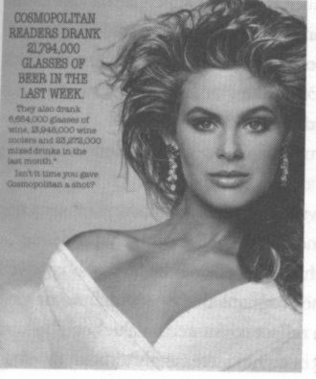
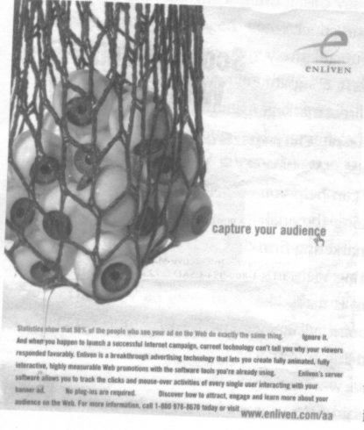
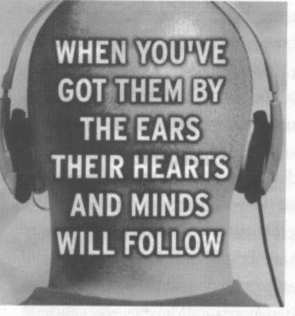

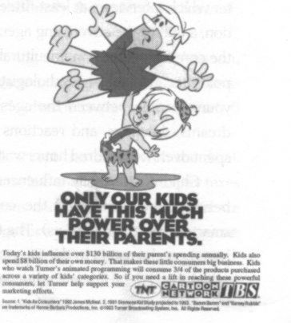

Slide 3
Who owns the media and why (profit? influence? both and more?)
Who deserves to become a subject – mentioned, quoted, portrayed, etc. - in the news?
Economic, political, coercive and symbolic power – interconnectivity

Slide 4
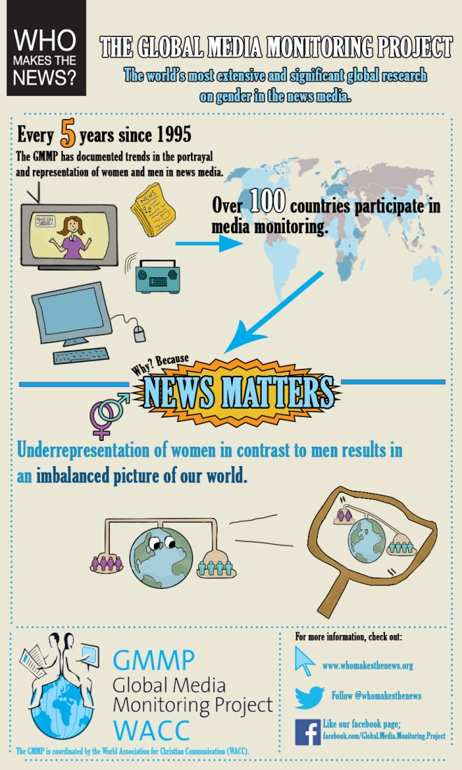
Global Media Monitoring Project GMMP

Slide 5
Quantitative - the number of women and men in the world's news, the type of story in which they are found, the roles they play in the news
Qualitative analysis
1. Blatant stereotype
Articles or images in which women are presented in stereotypical roles such as victims or sex objects.
Articles or images that reinforce notions of women’s domestic and men’s more public roles in ways that make this seem normal, e.g. a mother’s agony, rather than parents agony over a child.
Articles or images in which men are presented in stereotypical roles such as strong entrepreneurs or leaders.
Articles in which women are referred to according to personal relationships that have no relevance to the story; e.g. a woman minister is referred to as the wife of someone.
2. Subtle stereotype
Articles in which there is a lack of gender balance (and therefore of diversity) in sources, resulting in only one perspective being given on an issue.
3. Missed opportunities / Gender-blind (GB)
Articles that lack a gender perspective in every day issues such as elections or the budget, depriving these stories of new and interesting angles, such as how cuts in grants affect poor women.
4. Gender aware
Articles and images that challenge stereotypes and prompt debate on topical gender issues from a human rights perspective, such as women pilots or men care givers.
Articles that have a gender balance of sources; demonstrating different perspectives/impact on women and men including through use of gender disaggregated data; for example how many women and men receive certain types of grants; what they use them for and why cuts may have different kinds of impact.
Gender specific: Articles that concern inequality between women and men; structures, processes; campaigns to advance gender equality such as glass ceilings in certain types of occupation, etc.

Slide 6
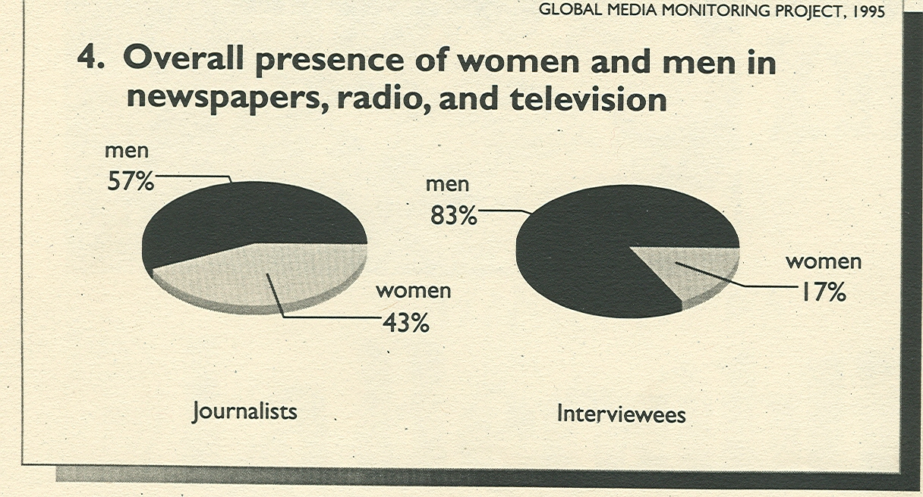
Global Media Monitoring, 1995
71 country

Slide 7
WHO MAKES THE NEWS, 2000
70 countries

Slide 8
1% in five years – statistically insignificant
160 YEARS

Slide 9
2005
76 countries
21%

Slide 10
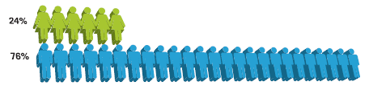
2010
100 countries

Slide 11
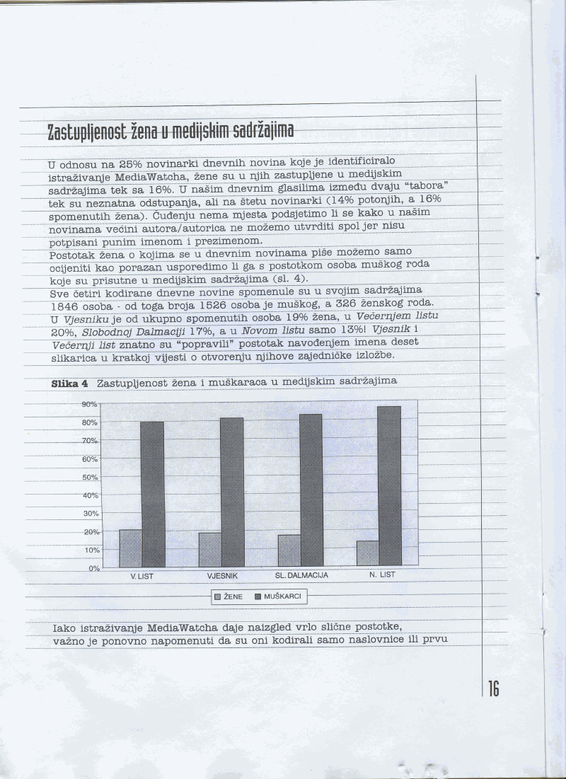
Večernji list – 20%
Vjesnik – 19%
Slobodna Dalmacija – 17%
Novi list – 13%

Slide 12
Topics and occupation
Health: 33%
Social issues: 33%
Arts/entertainment: 31%
Politics/government: 7%
politicians – 6%; Government – 7%; police/army – 2%; civil servants – 55%, unemployed – 40%...

Slide 13
Text/segment of an article – Večernji list
’Žene su konformisti, pasivne, mentalno inferiorne, nestabilne, namiguše i prepredene kad je riječ o mržnji ili zlobi”, piše, kako javlja madridski list El pais, profesor psihologije na…”
Women are conformists, passive, mentally inferior, unstable, jilts and foxy, when hate and venom are concerned.

Slide 14
2010
Croatia

Slide 15
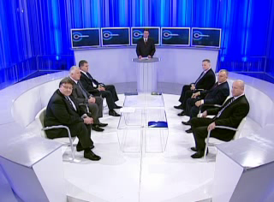
Otvoreno

Slide 16
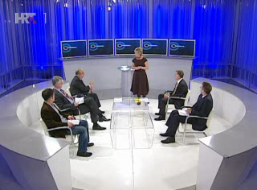
hegemony as A. Gramsci defines “consented” coercion? Or?

Slide 17
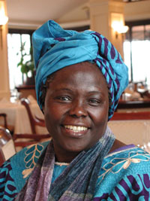

Slide 18
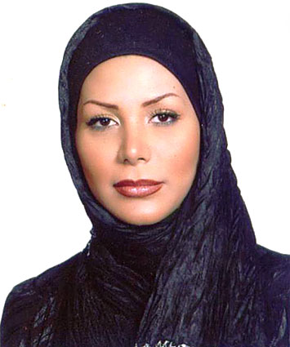

Slide 19
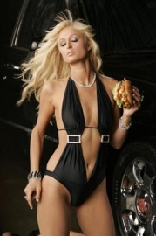

Slide 20


Slide 21
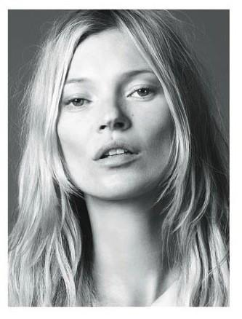

Slide 22
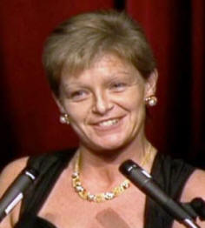

Slide 23
Wangari Maathai (1940-2011) Nobel Peace Prize winner for 2004 Kenya
Neda Agha Soltan (1983.-2009.) 26 years; killed in a peace protest in Teheran 2009
Paris Hilton
Anna Politkovskaya (1958.-2006.) 48 years, journalist, advocate for the human rights of Chechen refugees, murdered
Kate Moss – top model
Veronica Guerin (1958. – 1996.) 38 years, Ireland, investigative reporter, murdered

Slide 24
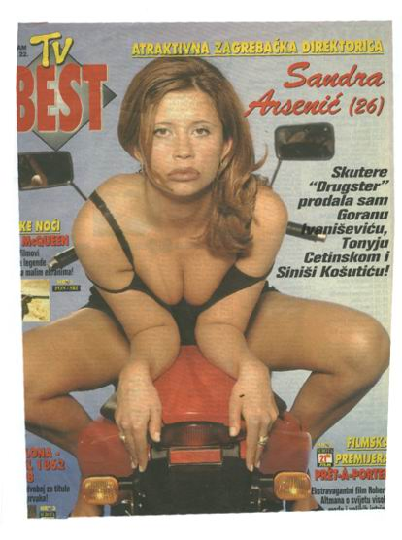
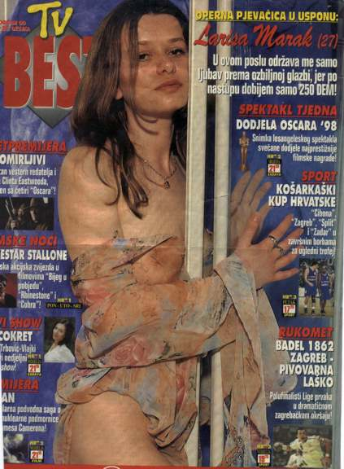

Slide 25
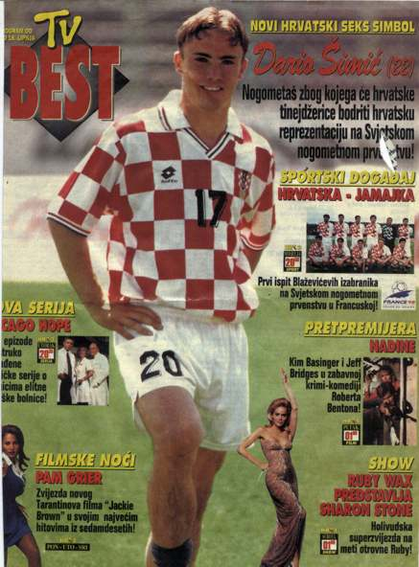

Slide 26
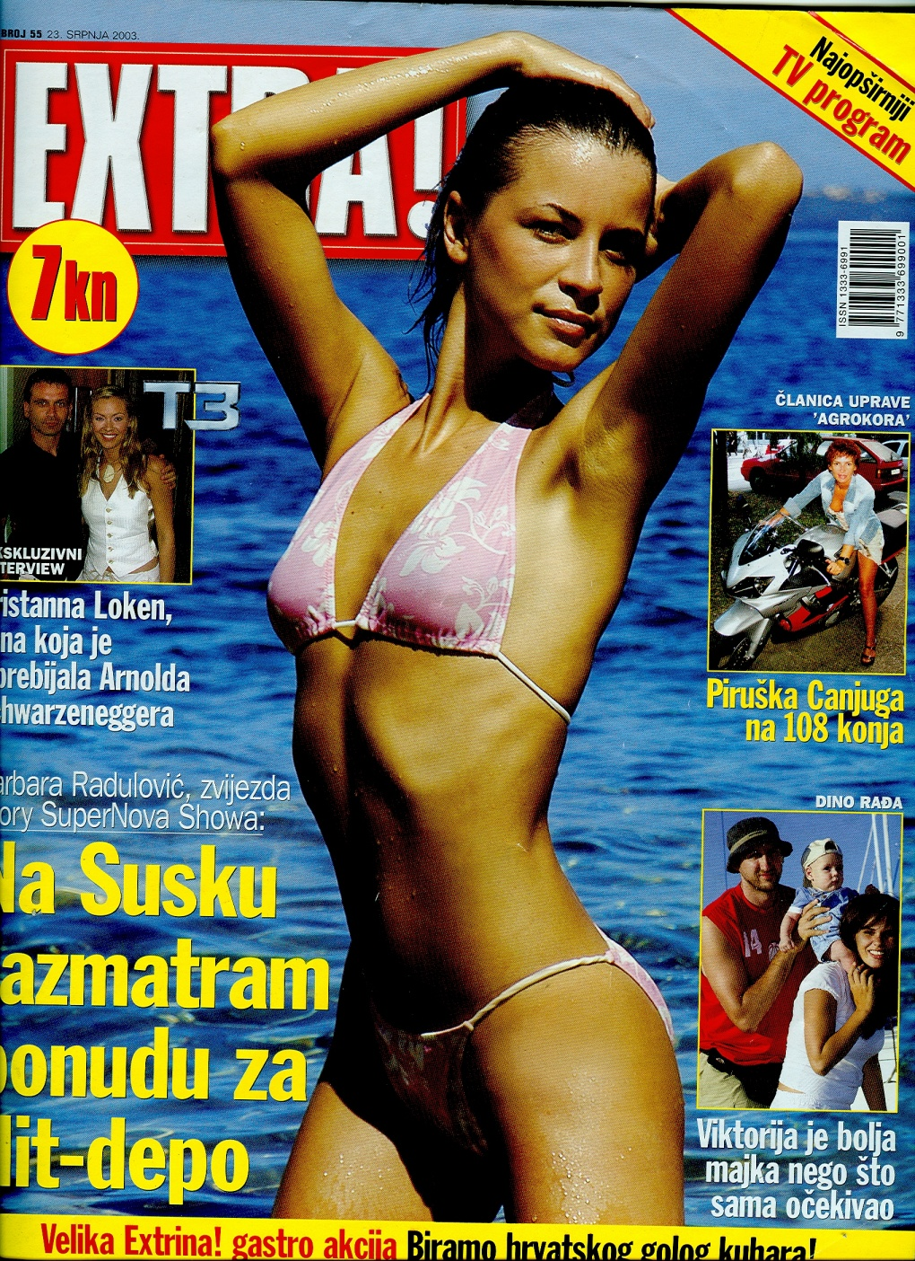
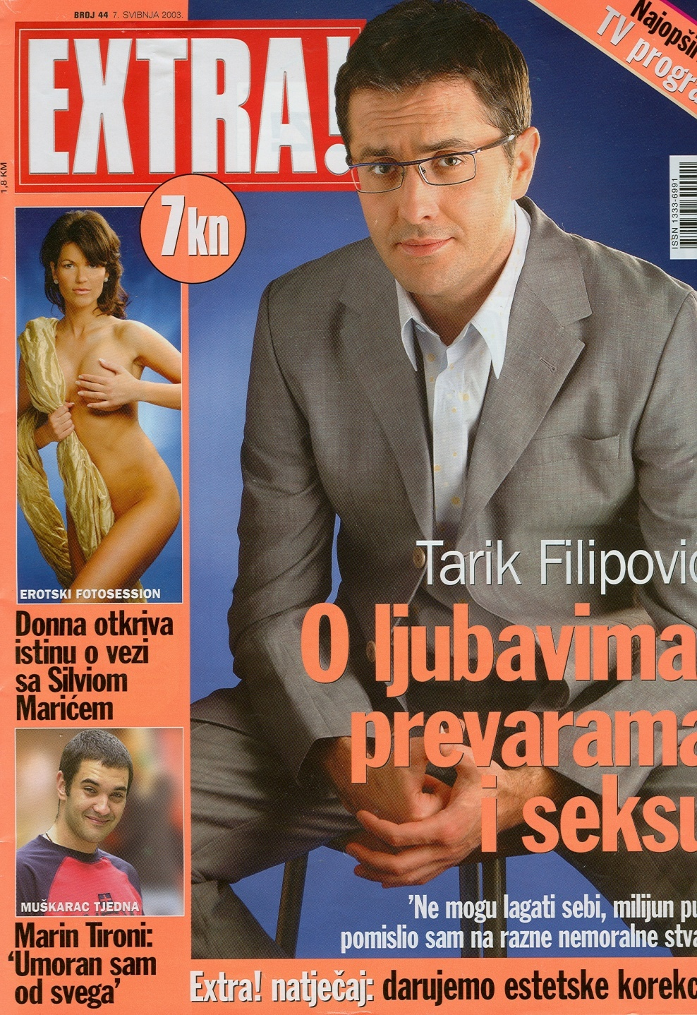

Slide 27
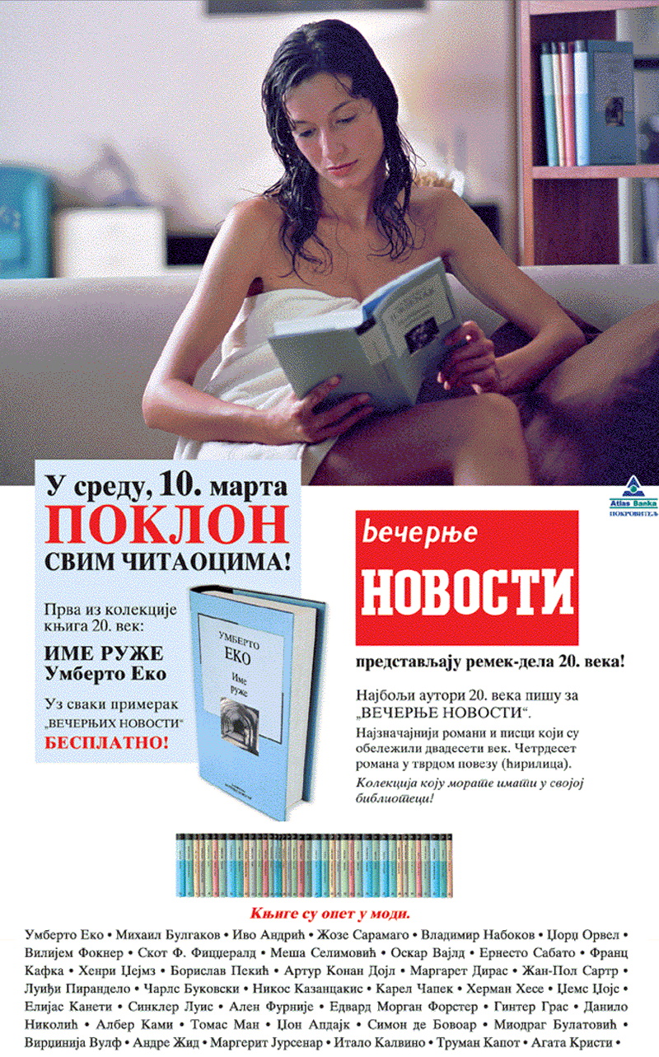
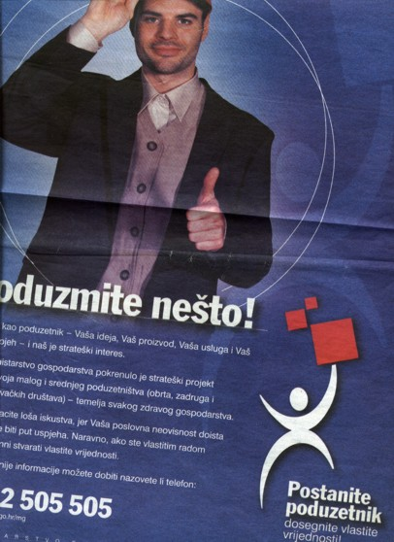

Slide 28



Slide 29
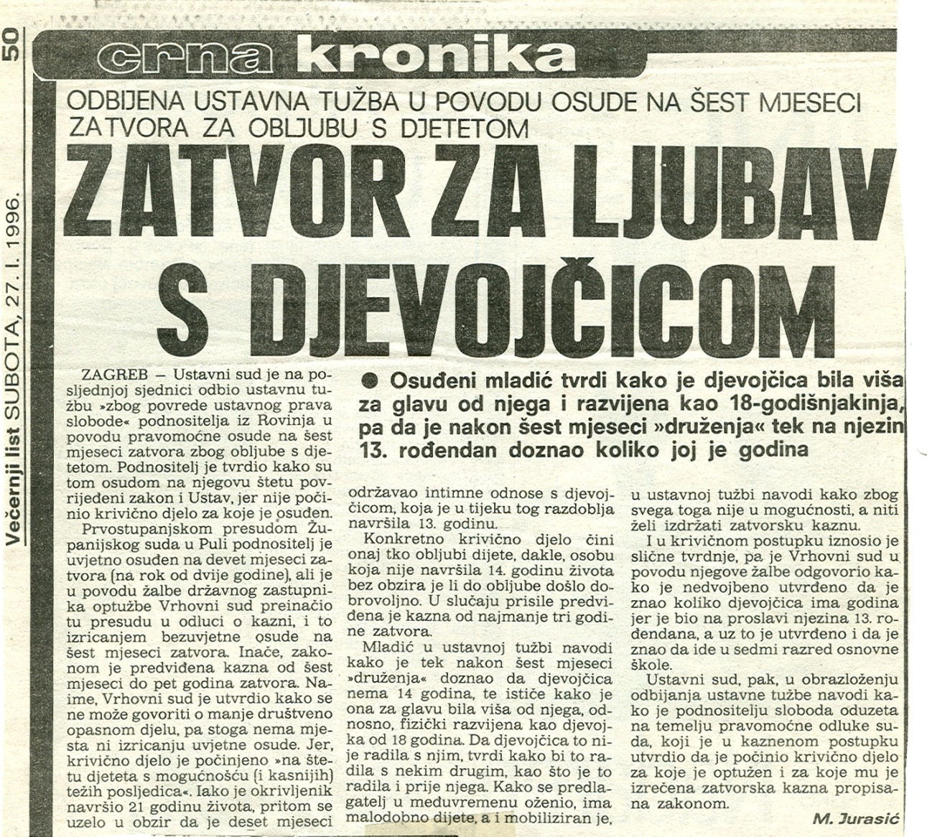
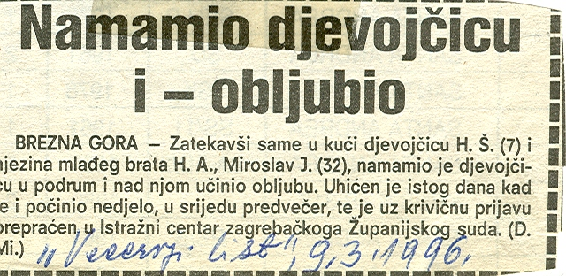

Slide 30



Slide 31





